Slide 1
Using Old Information to Learn New Information
Mrs. Henderson’s 4th grade
Old Wire Elementary
Rogers, Arkansas
November 18, 2011

Slide 2
Mrs. Henderson began her planning with the Arkansas State Standard student learning expectation she wanted her students to perform.
Because she will be implementing the Common Core State Standards next year, she made a connection to the new standards.

Slide 3
Anchor Standard 1: Read closely to determine what the text says explicitly and to make logical inferences from it; cite specific textual evidence when writing or speaking to support conclusions drawn from the text.
K | With prompting and support, ask and answer questions about key details in a text.
1st | Ask and answer questions about key details in a text.
2nd | Ask and answer such questions as who, what, where, when, why and how to demonstrate understanding of key details in a text.
3rd | Ask and answer questions to demonstrate understanding of a text, referring explicitly to the text as the basis for the answer.
4th | Refer to details and examples in a text when explaining what the text says explicitly and when drawing inferences from the text.
5th | Quote accurately from a text when explaining what the text says explicitly and when drawing inferences from the text.
6th | Cite textual evidence to support analysis of what the text says explicitly as well as inferences drawn from the text.
7th | Cite several pieces of textual evidence to support analysis of what the text says explicitly as well as inferences drawn from the text.
8th | Cite the textual evidence that most strongly supports an analysis of what the text says explicitly as well as inferences drawn from the text.
9-10 | Cite strong and thorough textual evidence to support analysis of what the text says explicitly as well as inferences drawn from the text.
11-12 | Cite strong and thorough textual evidence to support analysis of what the text says explicitly as well as inferences drawn from the text, including determining where the text leaves matters uncertain.

Slide 4
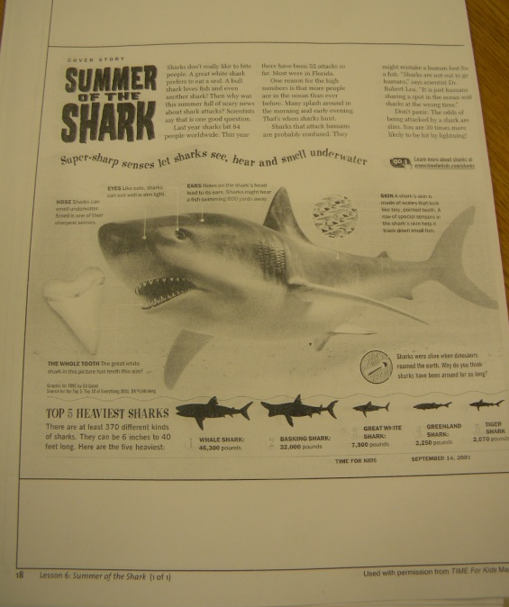
Using resources from The Comprehension Toolkit (Harvey and Goudvis), she planned her lesson.

Slide 5
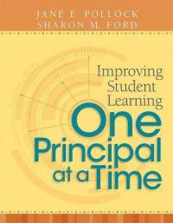
GANAG is a lesson structure that allows teachers to plan for student use of research based instructional strategies.
G= goal
A= access prior knowledge
N= new information
A= application
G= generalize the goal

Slide 6
The purpose of the GANAG structure
To give students the opportunity to actively use the nine high-yield strategies:
(2) Identifying Similarities and Differences
(7) Cooperative Learning
(8) Setting Objectives and Providing Feedback
(3) Summarizing and Note Taking
(4) Reinforcing Effort and Providing Recognition
(9) Generating and Testing Hypotheses
(5) Homework and Practice
(10) Cues, Questions and Advance Organizers
(6) Nonlinguistic Representations

Slide 7
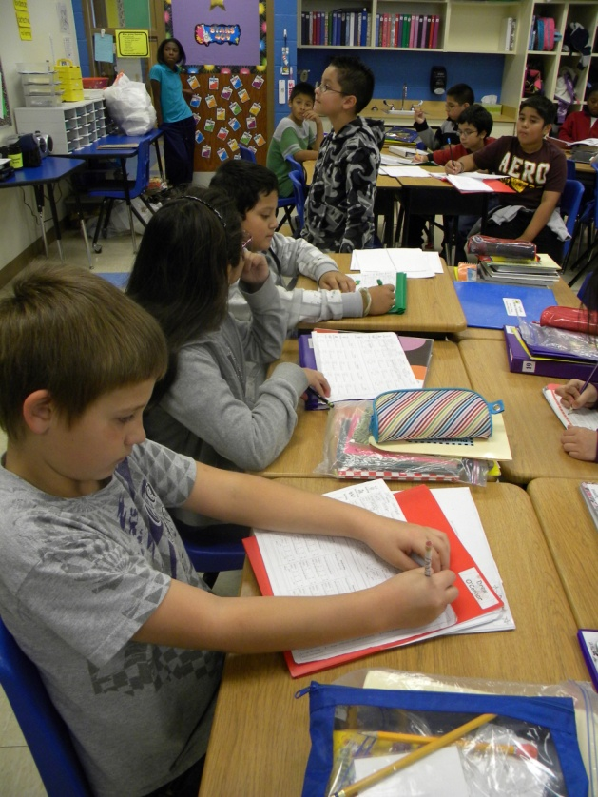
Goal: Today we will learn:
Students wrote the goal and scored themselves on their objective score sheets.
1= I don’t know what you are talking about
2= I know a little about it, but am not sure how to use it.
3= I know about it, but could still use some practice.
4= I know above and beyond.
(8) Setting Objectives and Providing Feedback

Slide 8
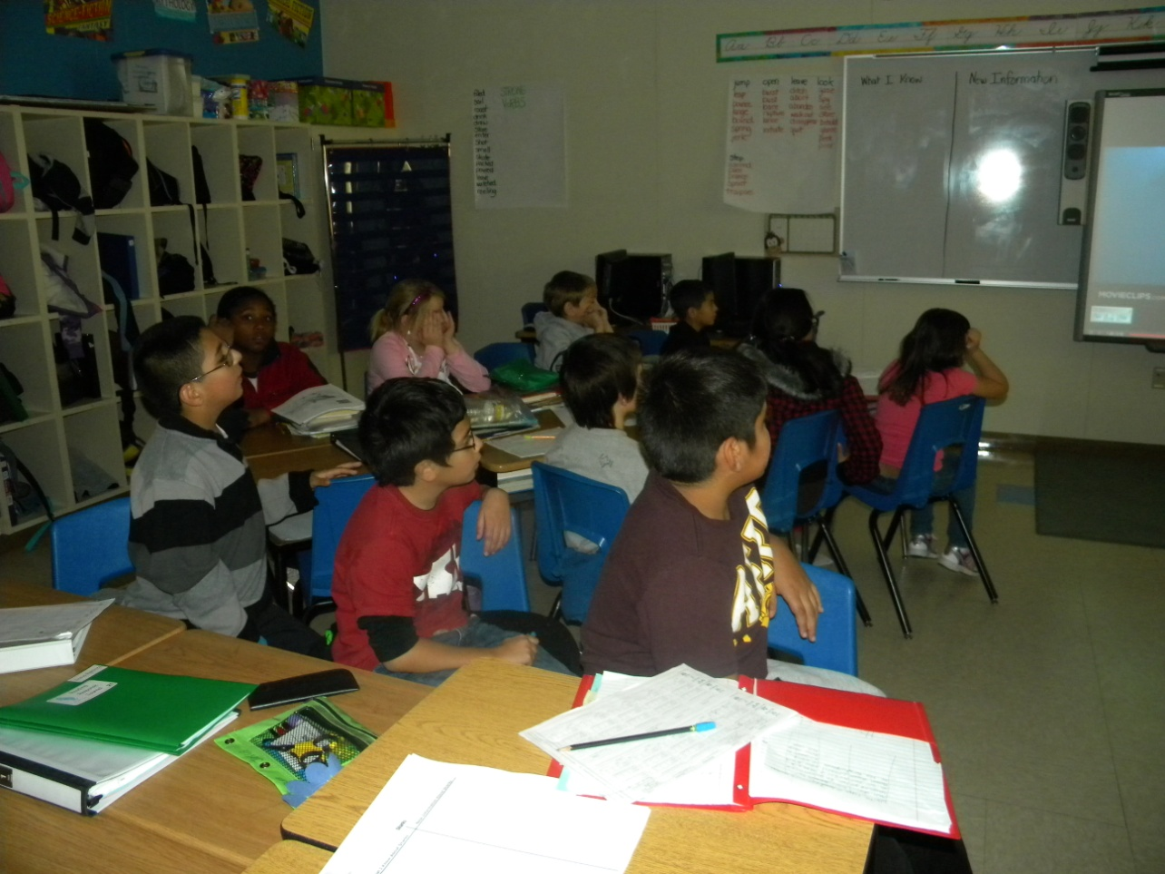
Accessing Prior Knowledge
Students viewed a video clip about sharks.
(6) Nonlinguistic Representations

Slide 9
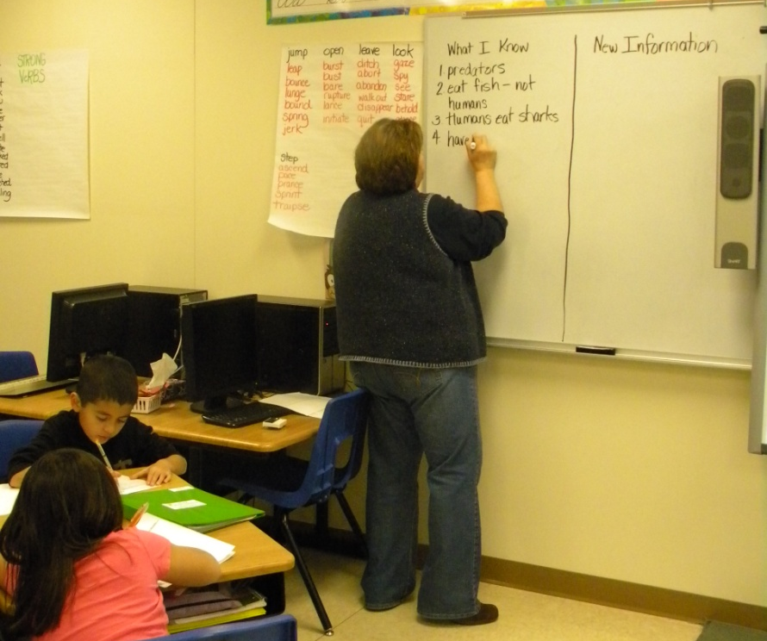
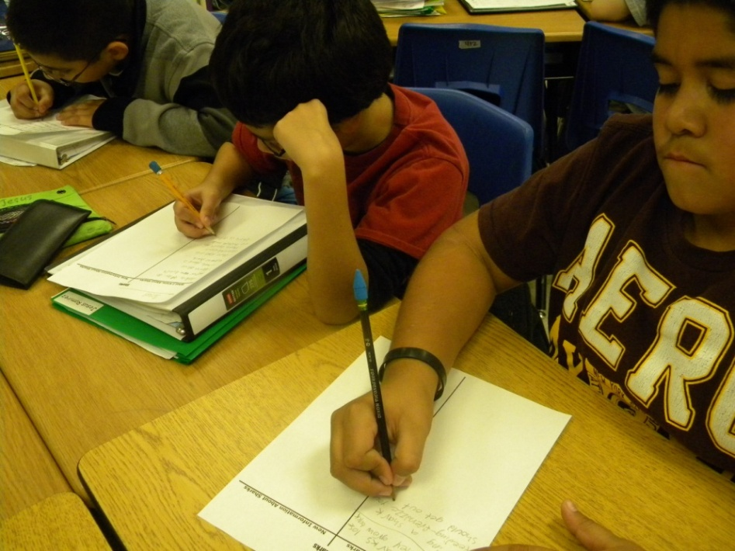
New Information
The timer was set for three minutes.
“What old information do you have about sharks?”
Everyone added what they already knew about sharks to the left side of their t-chart .
(10) Cues, Questions and Advance Organizers
(3) Summarizing and Note Taking

Slide 10
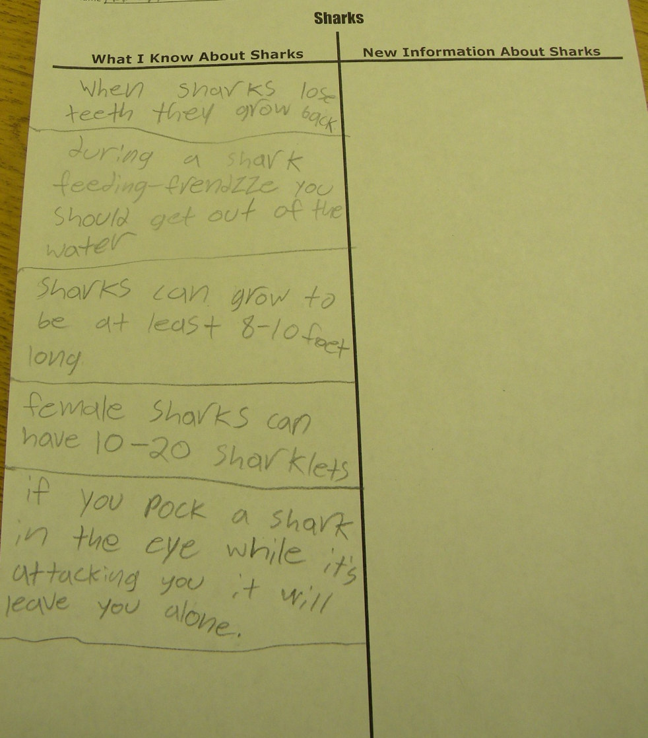
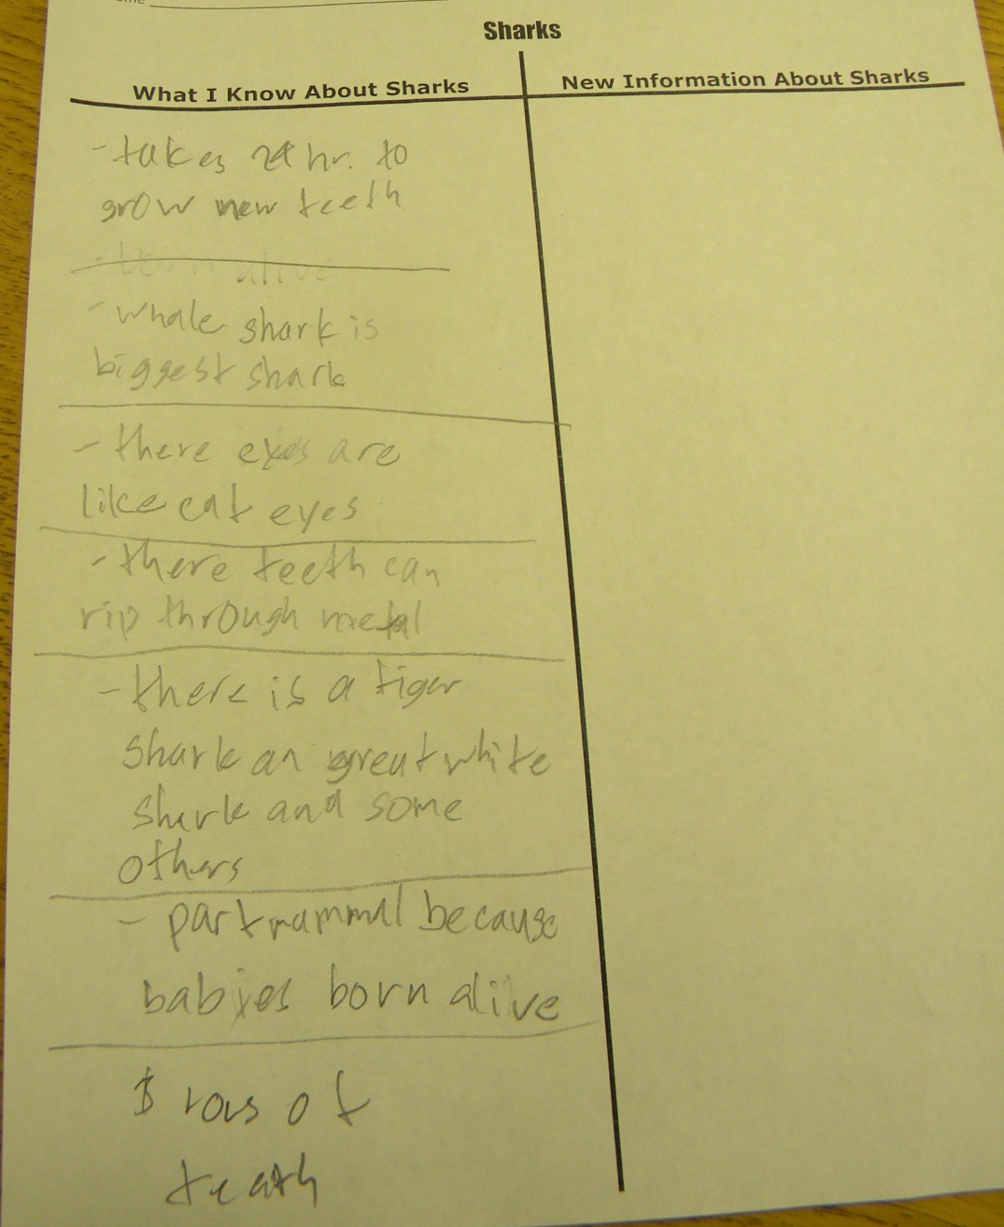
(3) Summarizing and Note Taking

Slide 11
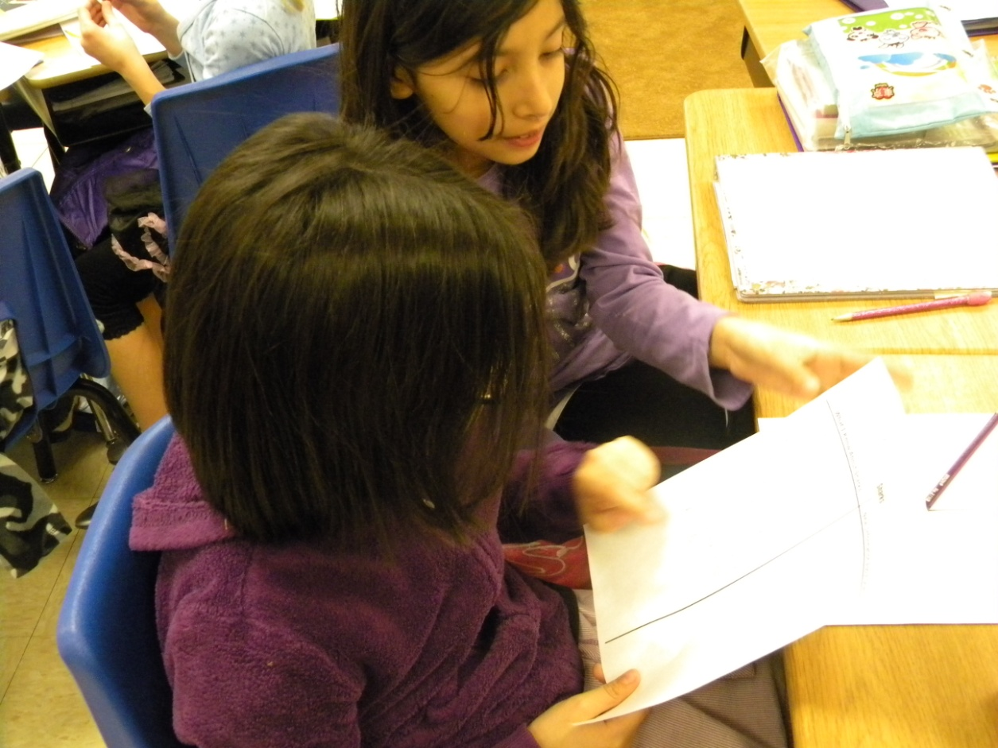
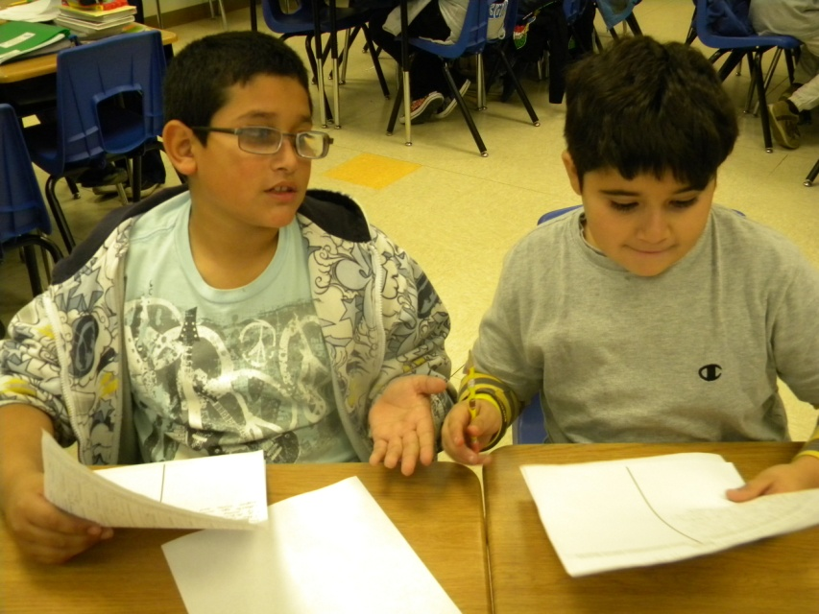
“Turn and Talk with a partner. Share what you already know about sharks.”
(7) Cooperative Learning

Slide 12
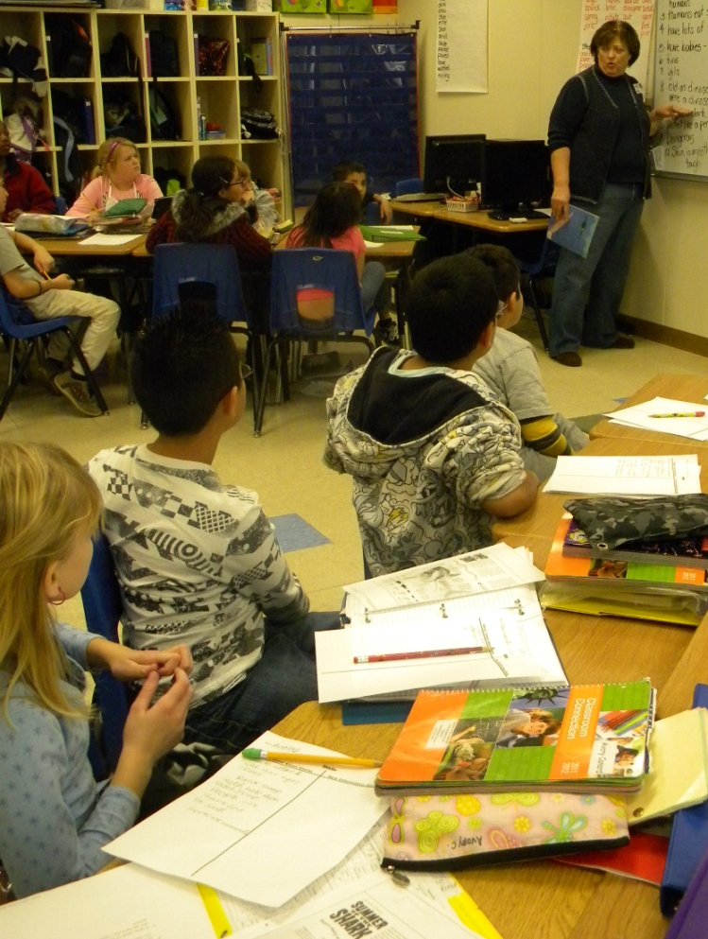
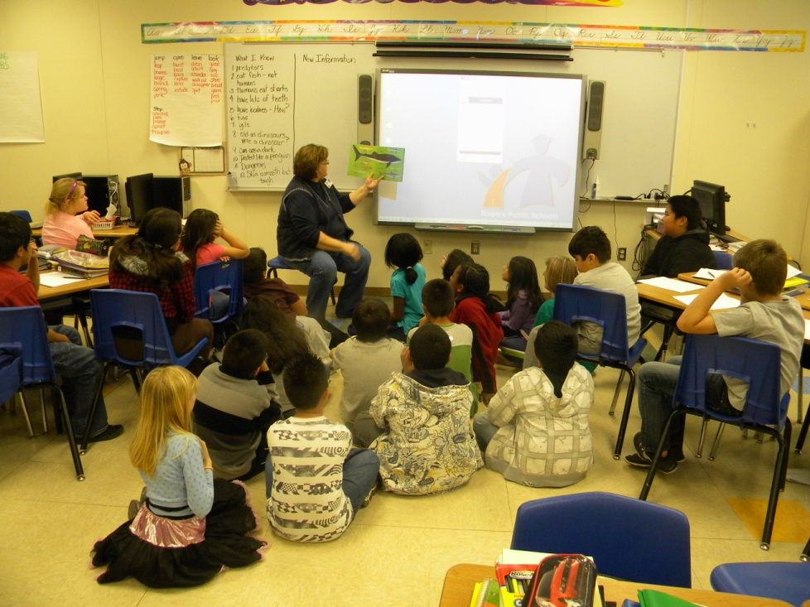
Surprising Sharks
Nicola Davies (2003)
Mrs. Henderson shared what she knew about sharks and then invited the students to join her as she read an informational text.

Slide 13
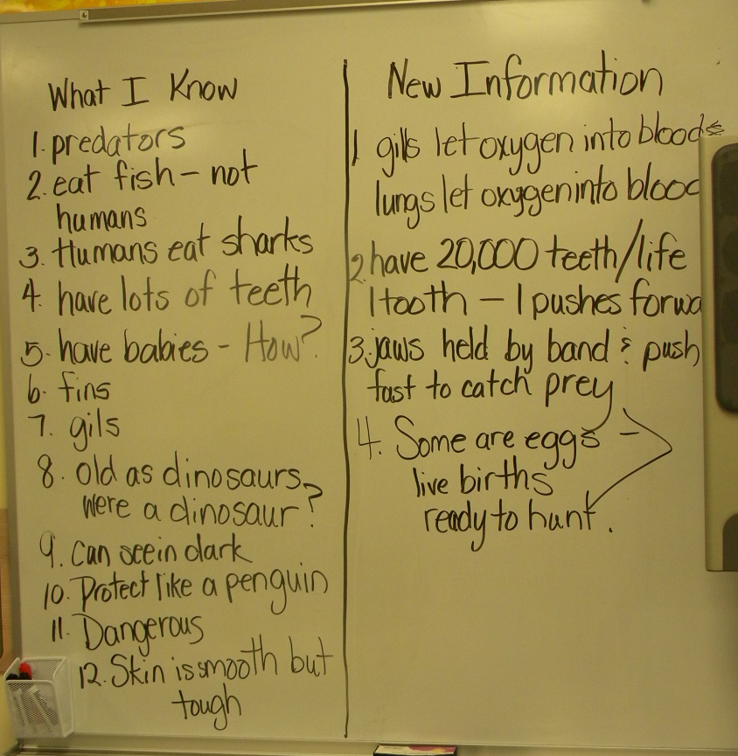
Mrs. Henderson modeled pausing and adding new information she learned from the text to her t-chart .
(3) Summarizing and Note Taking

Slide 14
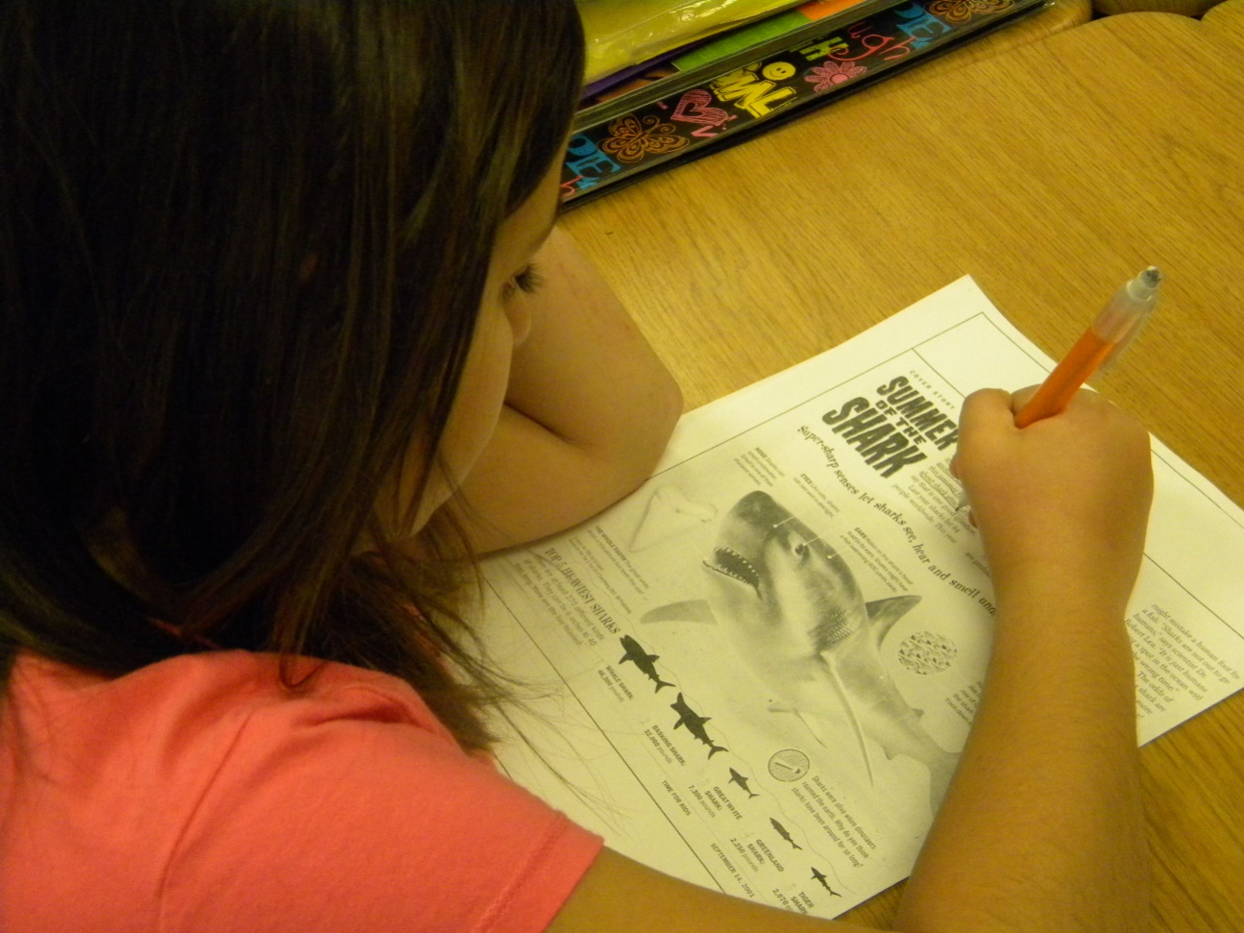
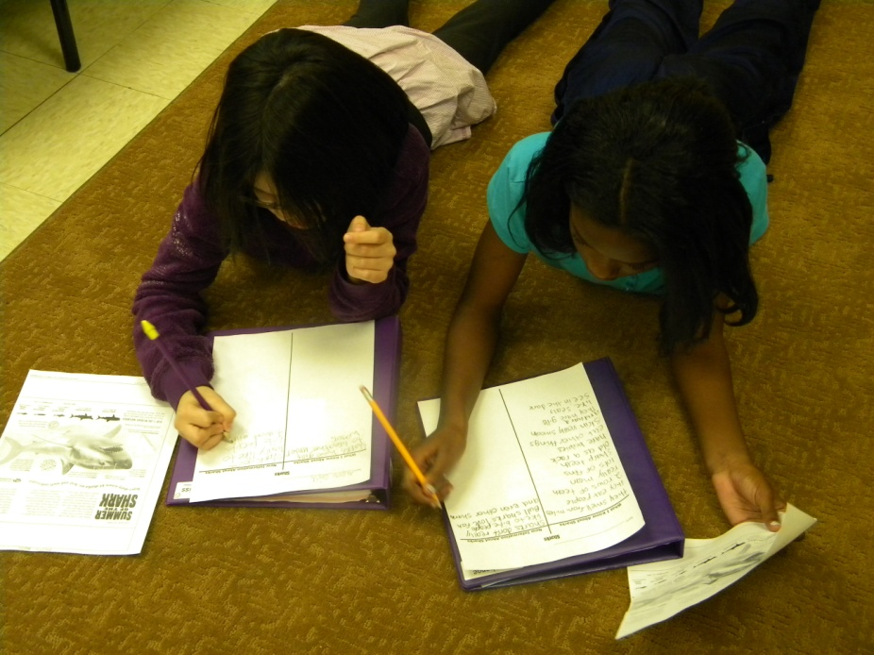
Application
Students read a nonfiction article about sharks and added new information to their t-charts.
(3) Summarizing and Note Taking

Slide 15
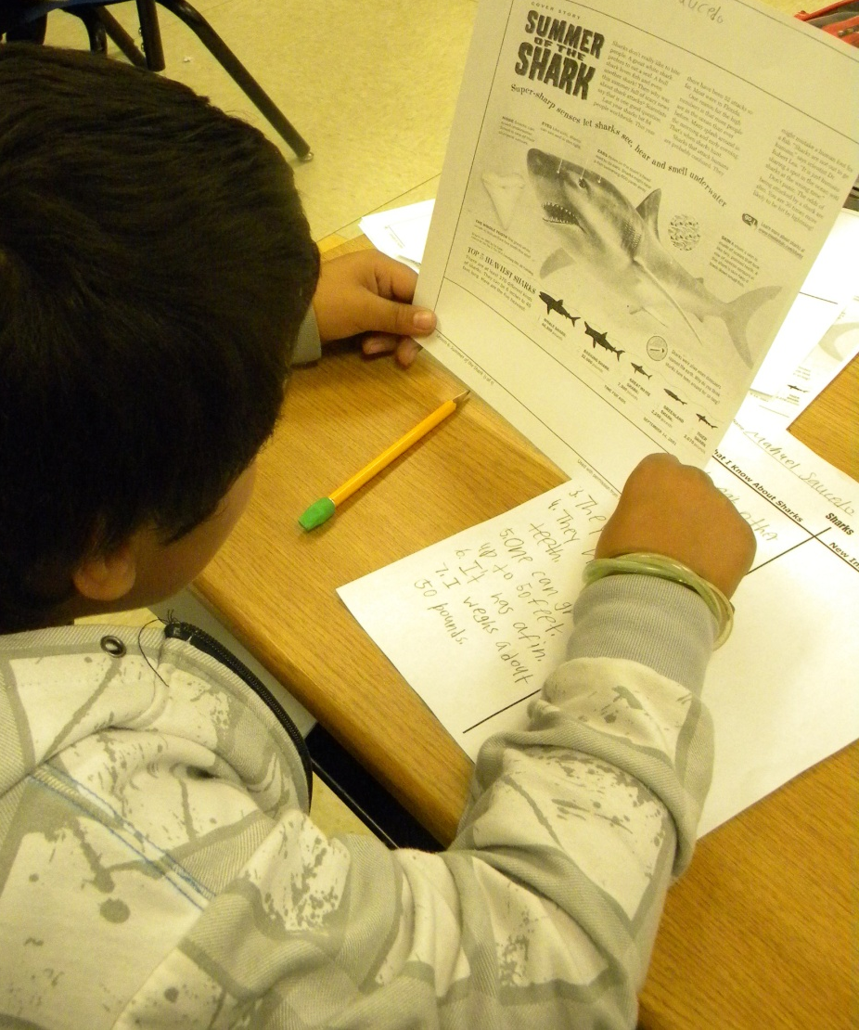
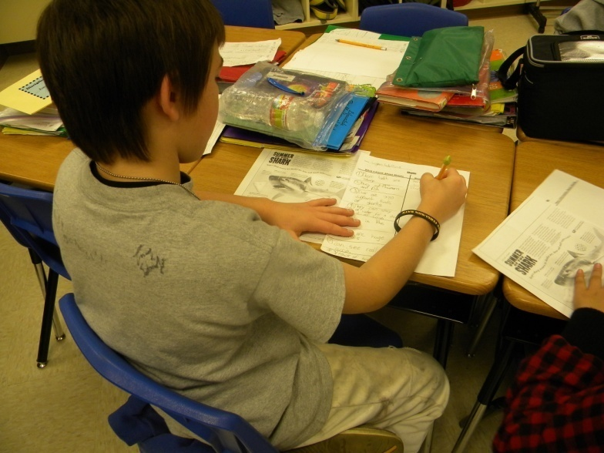
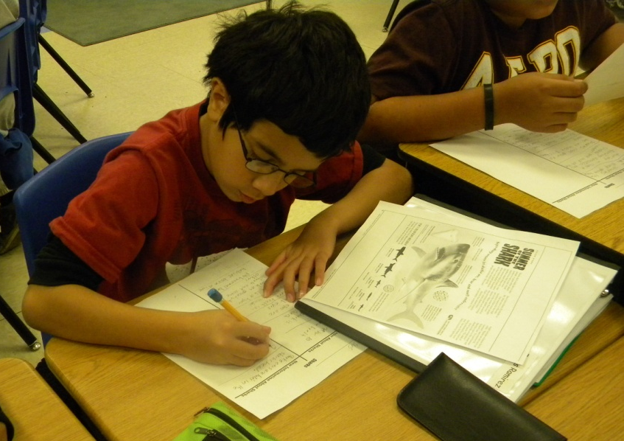
(3) Summarizing and Note Taking

Slide 16
New Information
Connecting old information to new information can…
Add to our knowledge
Change our thinking
Clear up misconceptions
Mrs. Henderson modeled connecting the old information to the new information. She thought aloud and shared how the connections helped her learn the new information.

Slide 17
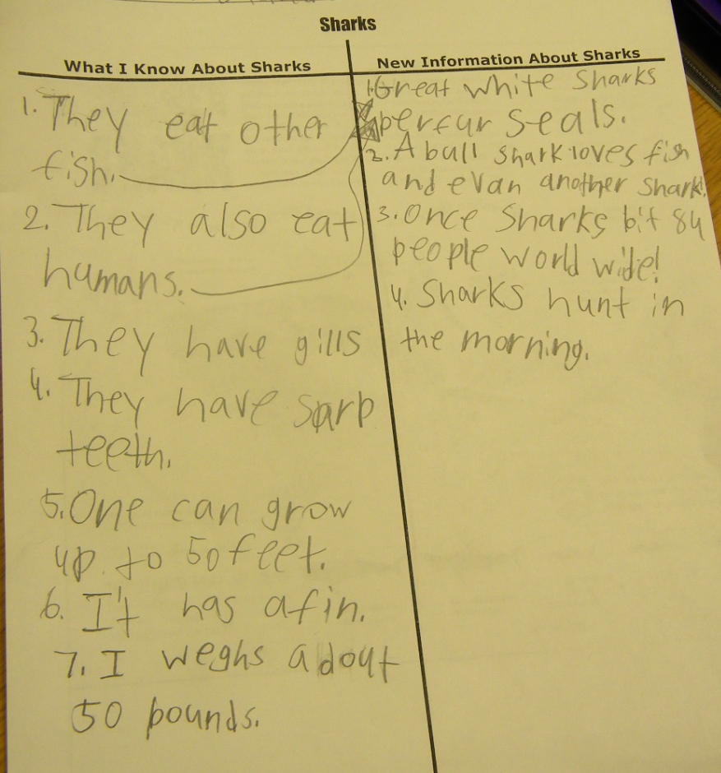
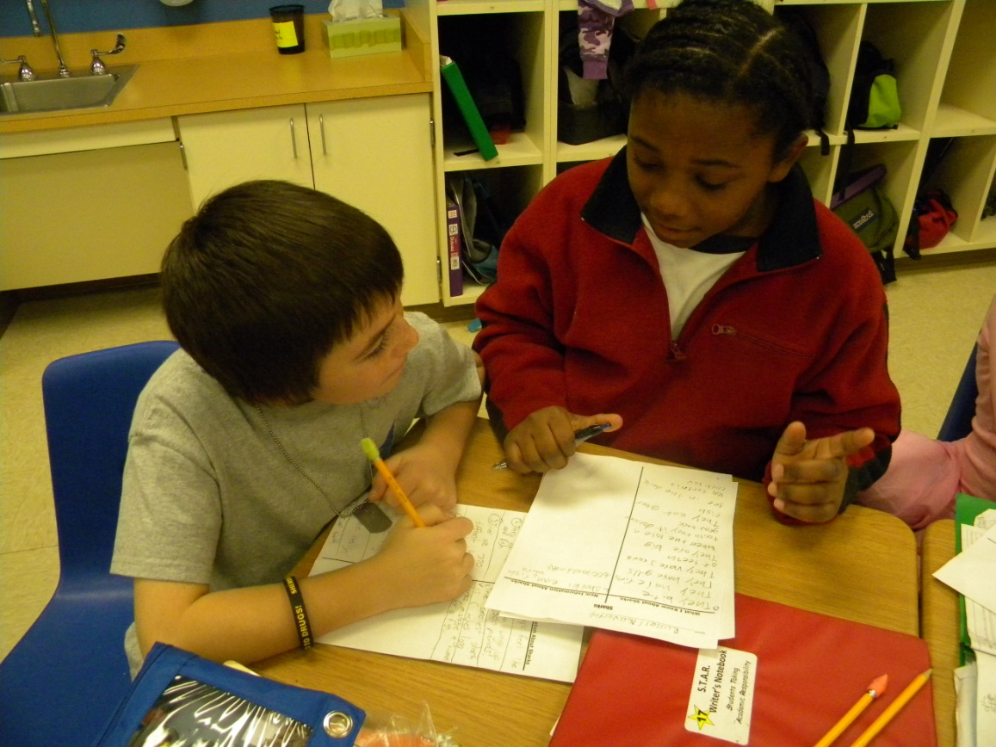
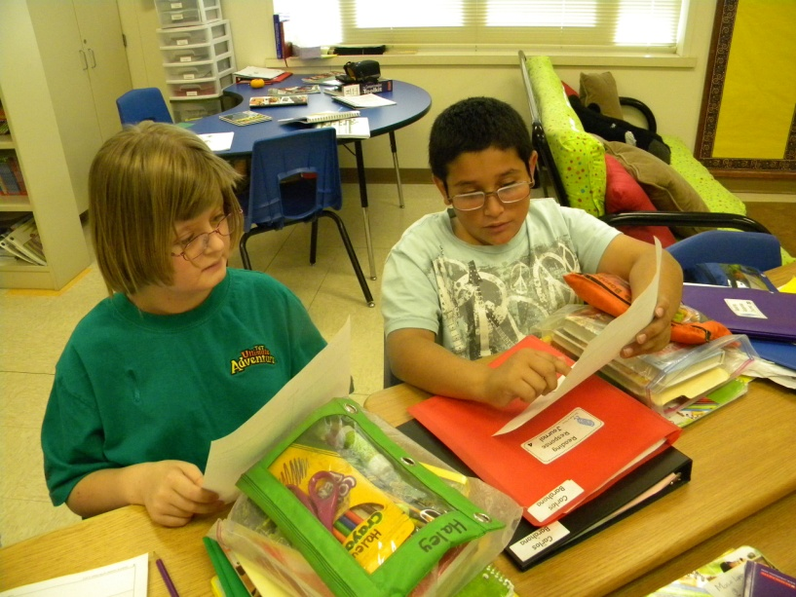
Application
Students worked with partners to make connections.
(2) Identifying Similarities and Differences
(7) Cooperative Learning

Slide 18
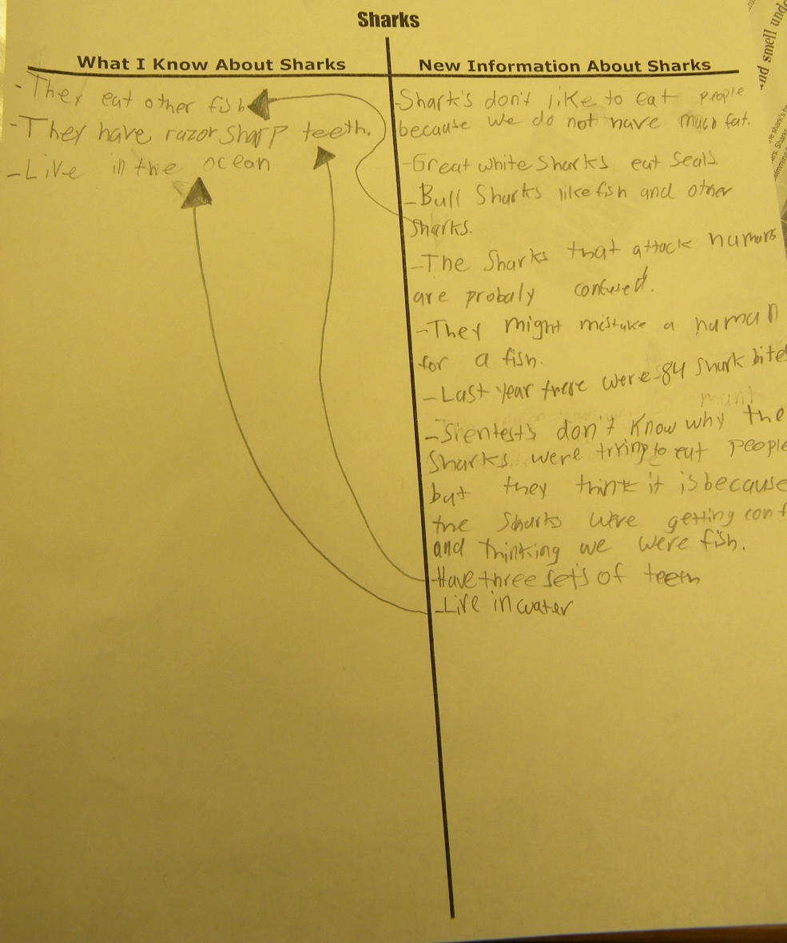
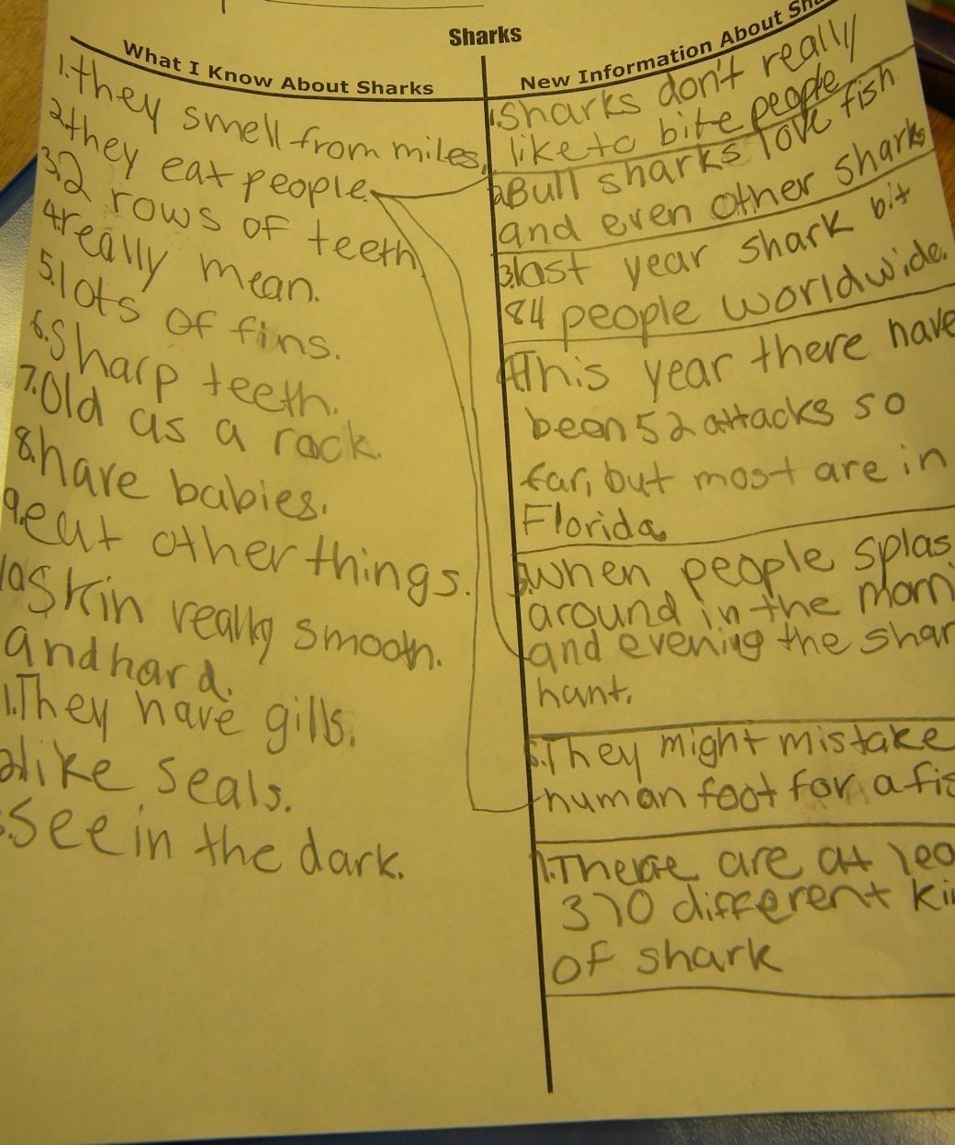

Slide 19
Generalize the Goal: Today we will learn:
Students scored themselves again on their objective score sheets.
(8) Setting Objectives and Providing Feedback

Slide 20
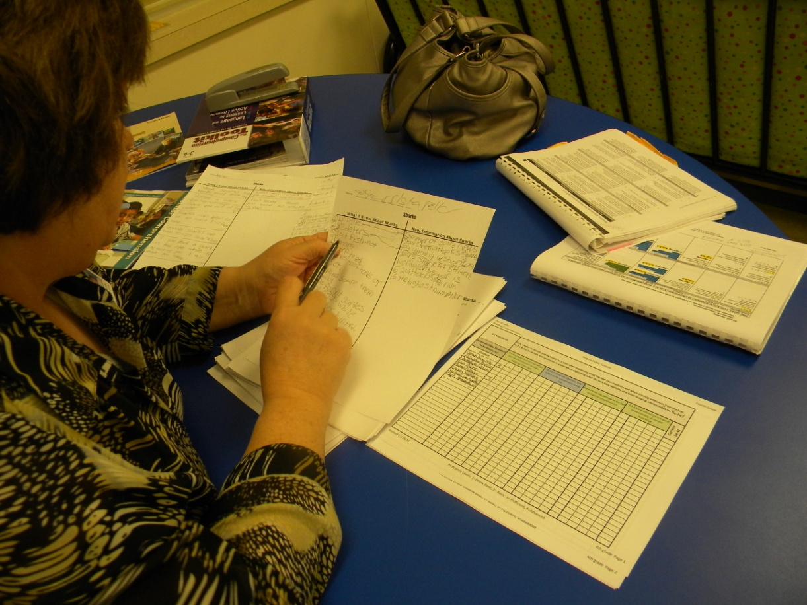
Later, Mrs. Henderson looked at the students' work to help her score their performance to the standard.
NC = no connections

Slide 21
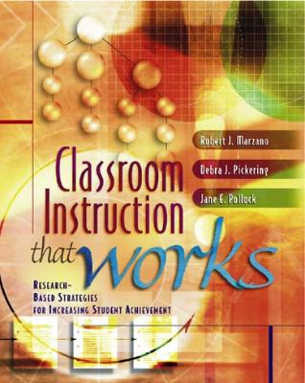
Marzano, R. J., Pickering, D. J., & Pollock, J. E. (2001). Classroom instruction that works: Research-based strategies for increasing student achievement. Alexandria, VA: Association for Supervision and Curriculum Development.
Pollock, J. E. (2007). Improving student learning one teacher at a time. Alexandria, VA: Association for Supervision and Curriculum Development.
Pollock, J. E., & Ford, Sharon M. (2009). Improving student learning one principal at a time. Alexandria, VA: Association for Supervision and Curriculum Development.

